Slide 1
Internal and external loops
Sandra Kaljula, Linnéa Svensson and
Dominique Ghaffari

Slide 2

Imperative programming
Focus on how rather than what
Defines program logic
Defines control flow as statements
Source: https://codeburst.io/declarative-vs-imperative-programming-a8a7c93d9ad2
Notes:
Image: https://betanews.com/2016/04/04/most-complex-programming-language/

Slide 3

External looping
How will the task be accomplished?
Number of iterations
Iteration body
Notes:
Image source: https://authorfarrah.com/2014/09/10/ikea-furniture-assembly-in-10-frustrating-steps/

Slide 4
An example
int total = 0;
for (int number = 1; number <= 10; number++) {
total += number;
}
Code example from Java: how to program.

Slide 5
More complex example
int sumOfEven = 0;
for(int i = 0; i <= 20; i +=2) {
if(i % 2 == 0) {
sumOfEven += i * 10;
}
}
Source: Lecture 3 - What is Functional Programming, Andreas Nilsson

Slide 6
There is another way...

Slide 7
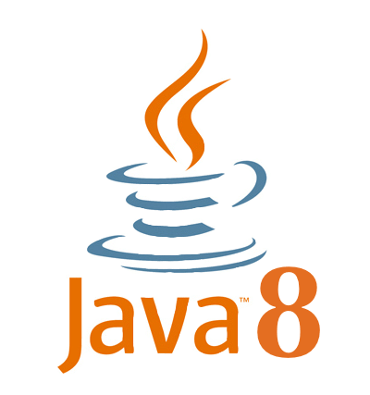
Streams and Lambdas
Why streams and lambdas?
Focus on what rather than how

Slide 8

Internal looping
Same results - less code
Java class
method
IntStream.rangeClosed(1, 10)
.sum();
Code example from Java: how to program.

Slide 9
Internal looping
Declarative programming
What we want to accomplish instead of how to accomplish it
Lambdas
(int x) -> {return x * 2;}
Code example from Java: how to program.

Slide 10
Previous example
int sumOfEven = 0;
for(int i = 0; i <= 20; i +=2) {
if(i % 2 == 0) {
sumOfEven += i * 10;
}
}
Source: Lecture 3 - What is Functional Programming, Andreas Nilsson

Slide 11
Internal looping
int sumOfEven = IntStream.rangeClosed(1, 20)
.filter (x -> x % 2 == 0)
.map (x -> x * 10)
.sum();
Source: Lecture 3 - What is Functional Programming, Andreas Nilsson

Slide 12
Pros and cons
External loops or internal loops? Why?

Slide 13
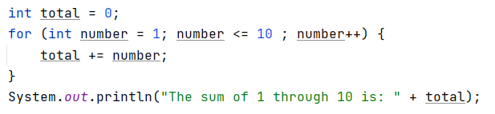
Discussion
Imperative programming
Errors
Incorrect values
Calculations
Code example from Java: how to program

Slide 14

Same loop using a stream
Declarative programming
Code example from Java: how to program.

Slide 15
Benefits of using Lambdas & Streams
Less mutability
Clean coding
Reliable
Effective

Slide 16
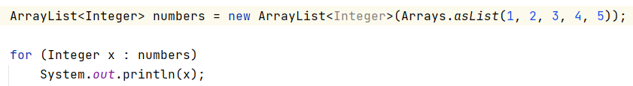

Disadvantages
Performance
Arrays & ArrayLists
Source: stackoverflow.com - In Java, what are the advantages of streams over loops.
Notes:
https://stackoverflow.com/questions/44180101/in-java-what-are-the-advantages-of-streams-over-loops

Slide 17

Same loop using a stream

Slide 18

Array
Benchmark result (comparison test)
Source: jaxenter.com - Java performance tutorial how fast are the java 8 streams.
Notes:
https://jaxenter.com/java-performance-tutorial-how-fast-are-the-java-8-streams-118830.html

Slide 19

ArrayList
Benchmark result
Source: jaxenter.com - java performance tutorial how fast are the java 8 streams.
Notes:
https://jaxenter.com/java-performance-tutorial-how-fast-are-the-java-8-streams-118830.html

Slide 20
ArrayLists Arrays
Accessed through iterators
Adds overhead
Boxing and unboxing collections
overhead: any combination of excess or indirect computation time
Index-based memory
No overhead
Source: jaxenter.com - java performance tutorial how fast are the java 8 streams.
Notes:
https://jaxenter.com/java-performance-tutorial-how-fast-are-the-java-8-streams-118830.html

Slide 21
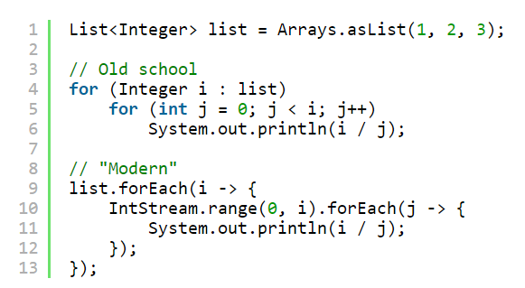
Arrays
Source: blog.jooq.org - 3 reasons why you shouldnt replace your for loops by streams foreach.
Notes:
https://blog.jooq.org/2015/12/08/3-reasons-why-you-shouldnt-replace-your-for-loops-by-stream-foreach/

Slide 22
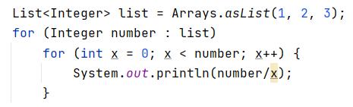
Exception
Source: blog.jooq.org - 3 reasons why you shouldnt replace your for loops by streams foreach.
Notes:
https://blog.jooq.org/2015/12/08/3-reasons-why-you-shouldnt-replace-your-for-loops-by-stream-foreach/

Slide 23
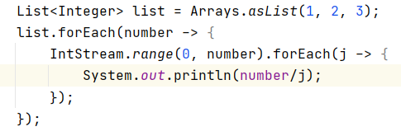
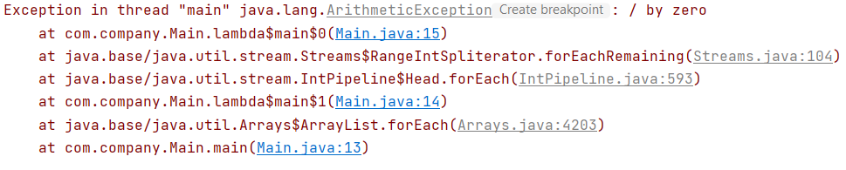
Exception
Source: blog.jooq.org - 3 reasons why you shouldnt replace your for loops by streams foreach.
Notes:
https://blog.jooq.org/2015/12/08/3-reasons-why-you-shouldnt-replace-your-for-loops-by-stream-foreach/

Slide 24


Slide 25

Notes:
https://www.english-learning.net/thank-vs-thanks/

